Slide 1

DESIGN AND IMPLEMENTATION OF SCADA SYSTEM FOR REMOTE INDUSTRIAL PLANT
MOHAMMED, Aliyu
AAU/SPS/FET/ELE/M.ENG/17/10600
Supervisor: Engr. Dr. Okundamiya, M. S.
Department of Electrical and Electronics Engineering,
Faculty of Engineering and Technology,
Ambrose Alli University,
Ekpoma, Nigeria.

Slide 2
Background to the Study
SCADA undergoes for Supervisory Control and Data Acquisition. This SCADA system refers to the mixture of telemetry and data acquisition.
The SCADA unit simplifies the survey and control of all the pant process easily and more conveniently.
In the present situation, the SCADA system has been used more widely and its scope is flourishing day by day, but thanks to the upper costs, the smaller and medium scale industries are within the reflection of using SCADA system in the monitoring of their plant processes.

Slide 3
Statement of the Problem
The major technology of SCADA involves PLC, hence increasing the cost of the SCADA system.
Companies develop proprietary software to communicate to their hardware. These systems are sold as “turnkey” solutions.
The main problem with this system is the overwhelming reliance on the supplier of the system.
Open software systems have gained popularity because of the interoperability they bring to the system

Slide 4
Aim and Objectives of the Study
The aim of the project is to design and implement a visual studio-based SCADA system for remote industrial plant.
The following are the specific objectives of the study:
To be able to determine the temperature and level of a process using sensors
To be able to develop a combination of hardware and software to monitor and control process parameter.
To be able to connect the microcontroller and the PC so as to feed the acquired data to the PC based application.

Slide 5
The Scope of the Study
The SCADA system described in this study is limited to two process variable that is temperature and level and the control action for both processes is manual and automatic. The automatic mode of the control is limited to ON/OFF control. The control can be done via the master station (the PC) or locally on the plant.

Slide 6
Research Methodology
Sensors are used to detect level and temperature in the process vessel. An Arduino uno microcontroller board is used to implement the control algorithm for the processes. Data collected from the sensors are constantly sent to the microcontroller which is in turn connected to a PC. At the front end, a SCADA software developed using microsoft visual studio is loaded on the computer which takes values from the microcontroller as measured from the process and displays them on its front panel. The screen is intended to allow user monitor the state of the processes and to set parameters like set point. USB to RS232 TTL module is used for the wired communication between the computer and the microcontroller.

Slide 7
Significant of the Study
The significance of this project is to develop a SCADA system that is cheaper than the available one.
These systems find applications in:
Food and Beverage Processing:
Plastic Production
In crude gathering system

Slide 8
Review of Literatures Related to SCADA Control
Engin and Mevlut (2006) used a Java-enabled mobile phone as a client in a sample SCADA application in order to display and supervise the position of a sample prototype crane.
Muhammad, Sayed Muhammed and Ahmed, (2009) worked on a framework of Intranet-SCADA using LabVIEW based Data Acquisition and Management.
Parwal (2013) presents an implementation of fuzzy technique based on LabVIEW for control gas system, and develop a special testing machine for testing the weak points at the pipe connections e.g. pipe bends, and intermediate connections.

Slide 9
Review of Literatures Related to SCADA Control
Andreassen, Augrandjean, Blanko, Abola and Gomez. (2015) successfully developed and implemented a prototypes more customizable supervision using LabVIEW as an attractive alternative to WinCC.
Laith, Subhi, and Mohammed, (2017) designed and simulated a Supervisory Control and Data Acquisition (SCADA) system to control oil pipeline and depot plant.
Designed a low-cost industrial SCADA system for small and medium-sized enterprises (SMEs). The data acquisition of the loads was done using current sensors and uploading the data to the Blynk app for live observation using an Ethernet shield connected to the router through a LAN cable.

Slide 10
Review of Literatures Related to SCADA Control
From the reading of the above literatures, it was found that most SCADA study either uses specially designed software for the purpose of data acquisition which might be difficult for other professional to work on if there is a need to or they use PLC that are expensive and require high level programing skills. Also, there is a need to take advantage of internet of things (IoT) in the area of SCADA system development. The propose system has a reduced architecture used open source software and hardware and requires a low level programming skills.

Slide 11
Functional block diagram of the process control system
Temperature Sensor Unit
Controller Unit
Display Unit
Level Sensor Unit
Alarm Unit
Final Control Unit
Communication Unit
Final Control Element
PC

Slide 12
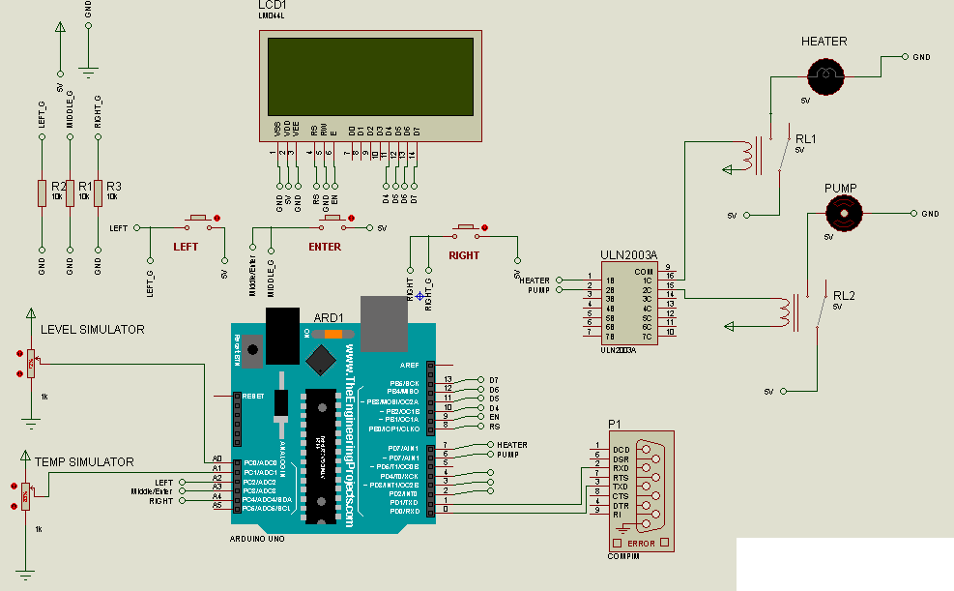

Slide 13
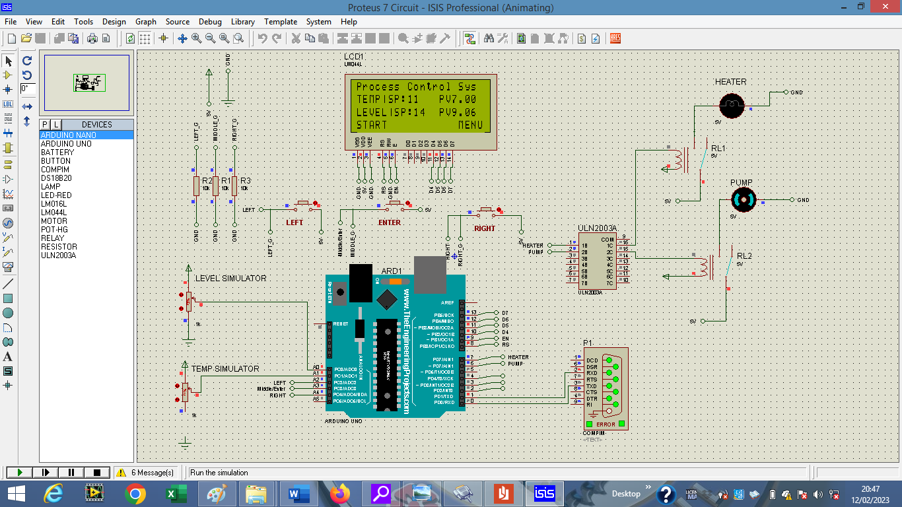
Results and Discussion
Circuit diagram of the simulated process

Slide 14
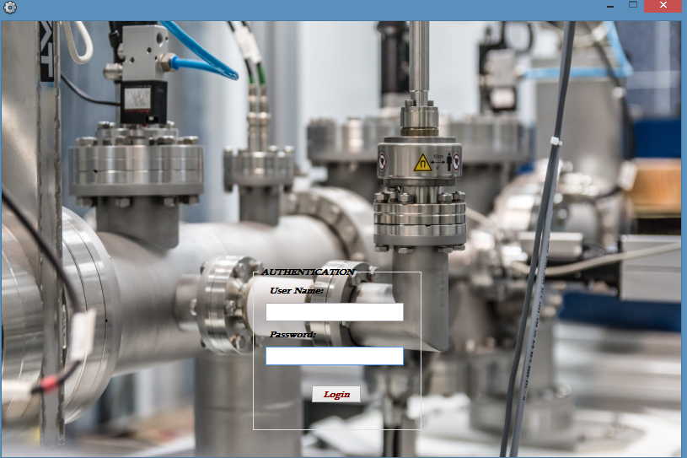
Results and Discussion
The login page of the SCADA software

Slide 15
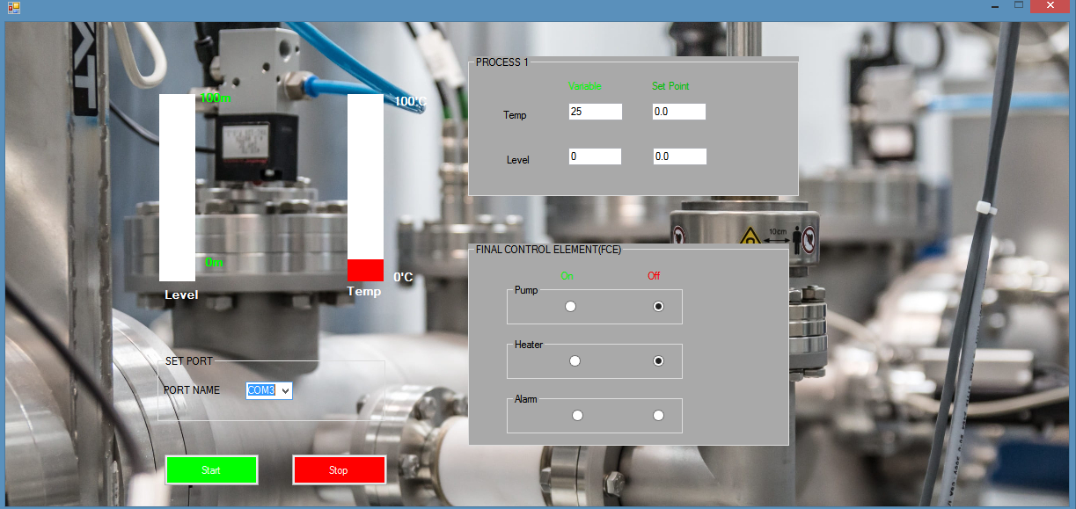
Results and Discussion
The SCADA front panel

Slide 16
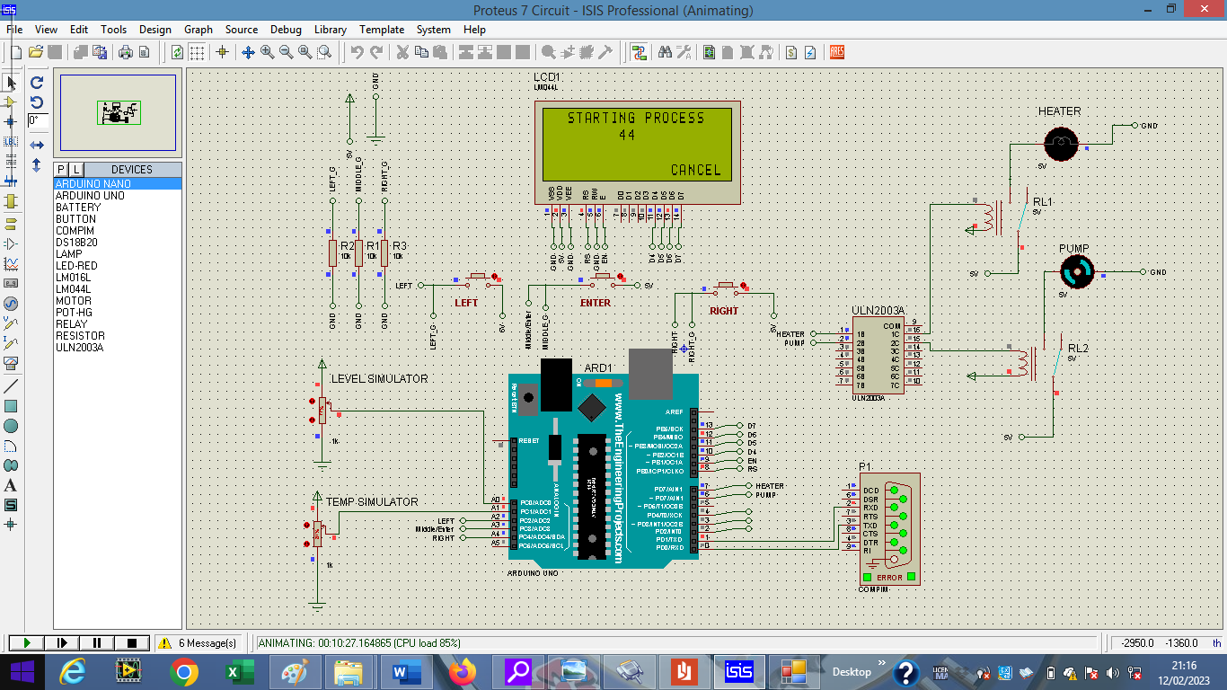
The initialization of the process at the press of the start button

Slide 17
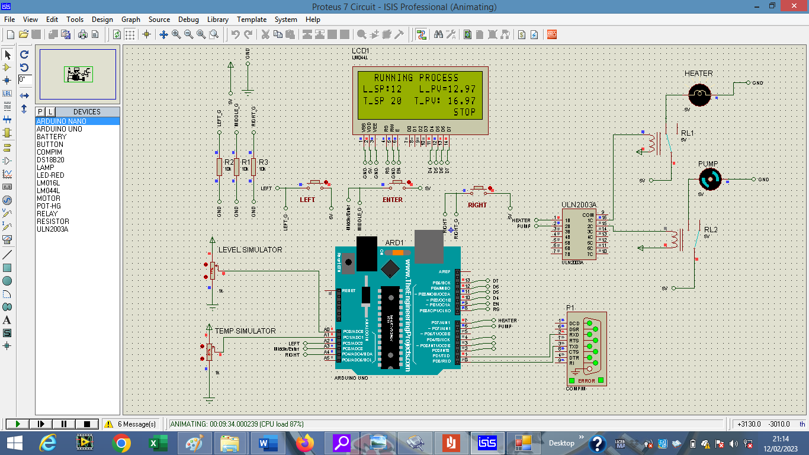
The process running in normal operation

Slide 18
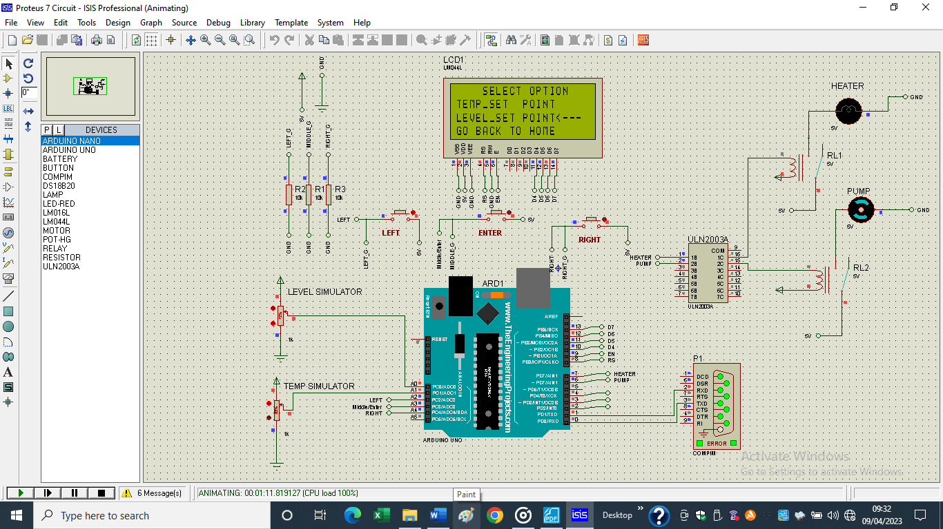
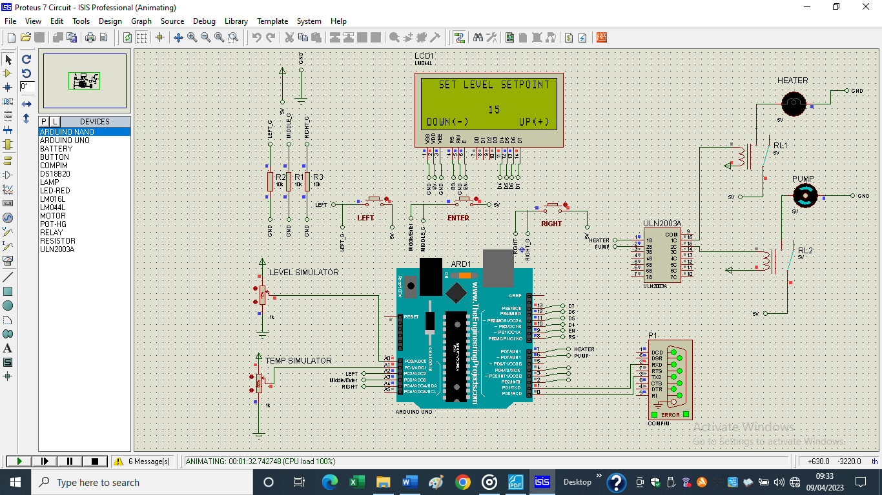
Inputting the setpoint

Slide 19
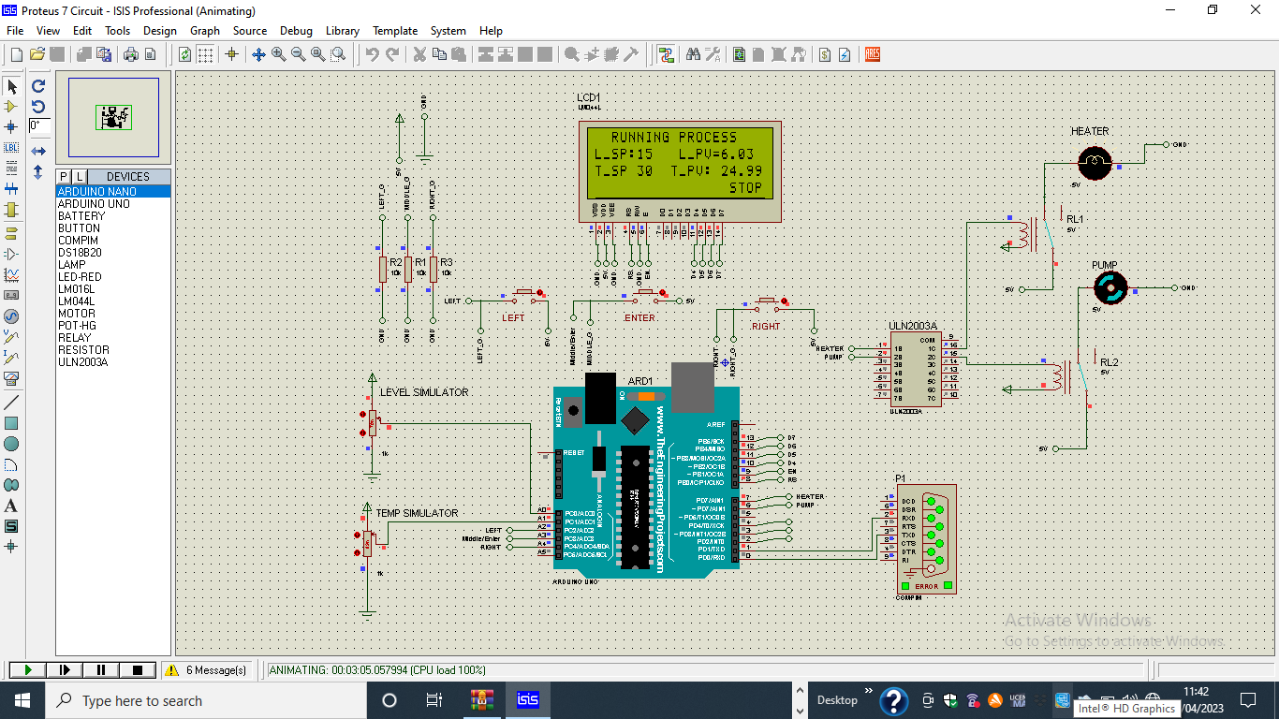
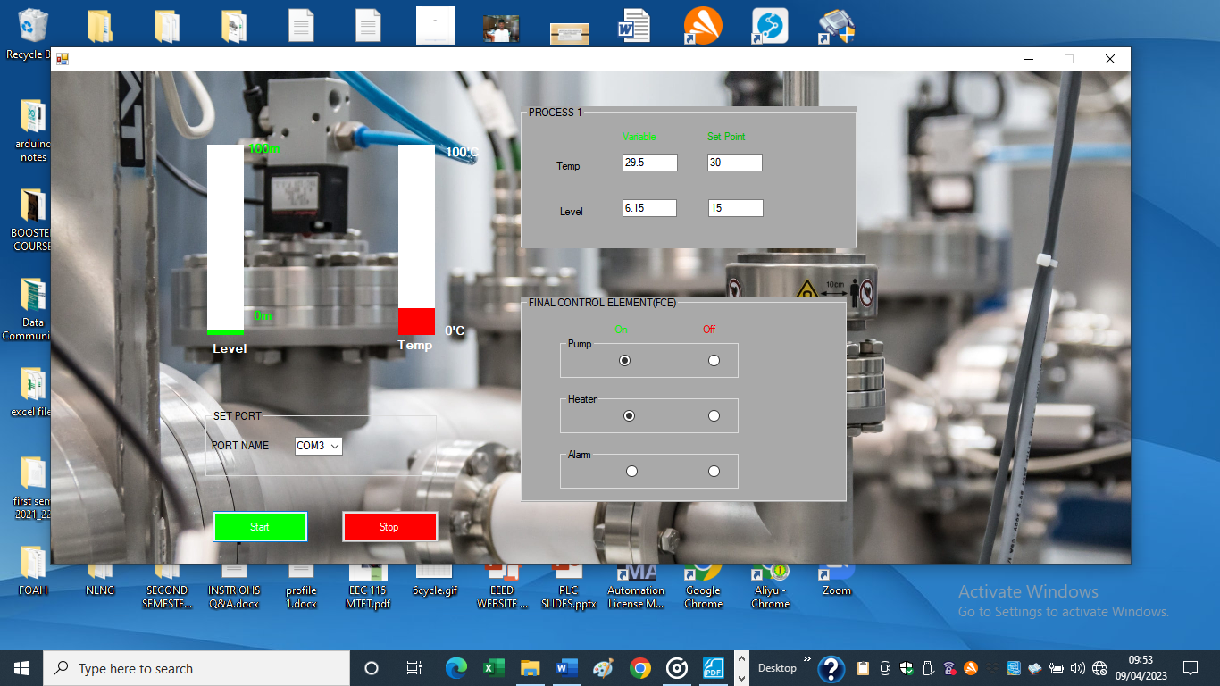
The simulation of the processes and the corresponding Scada software

Slide 20
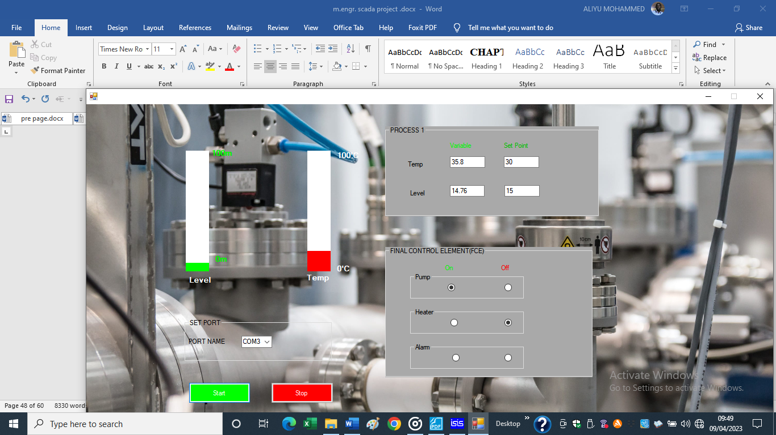
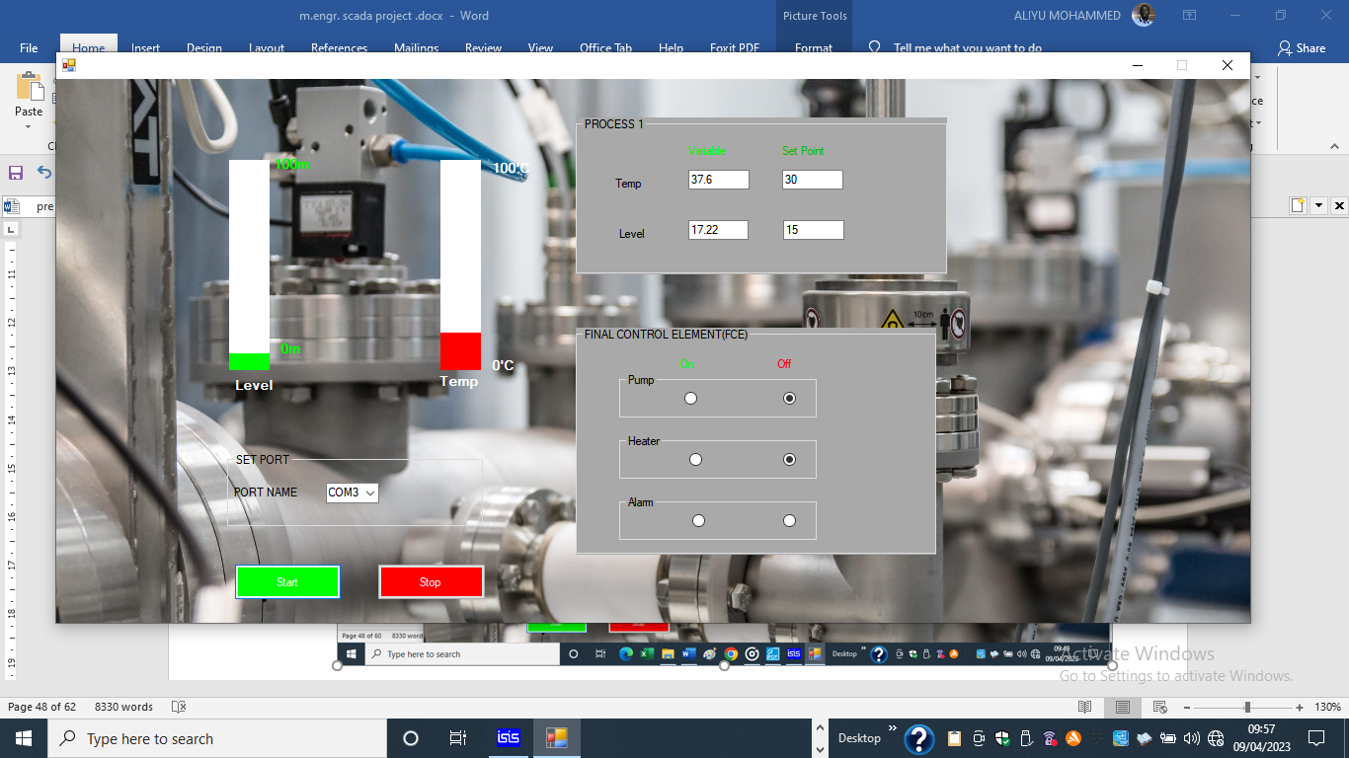

Slide 21
Findings
The effectiveness of this simulation depends largely on the similarity and sameness of the Baud rate and communication between SCADA software and the process controller. The following findings were reached;
An alternative low-cost SCADA system using open source software and devices can be developed.
The advent of new technology like virtual communication drivers can enable communication between filed devices and human machine interphase.
There are two open communication protocols that provide for interoperability between systems for telecontrol application DNP3 and T101

Slide 22
Contribution to Knowledge
This study has contributed to knowledge in the following ways:
A cost-effective SCADA software was built which could be used on any system running windows operating system
Multiple process control using a single front panel is developed
The developed system could be used in industrial process to reduce the problems encounter in the use of propriety software.

Slide 23
Conclusion and Recommendation
This project sought to design visual studio based SCADA system for use in transferring real-time data from industrial process to clients across a network. This system was developed and proved to meet the requirements of a flexible and scalable system suitable for widespread implementation.
There are several areas where future work should be conducted to improve the functionality of the system. One important area that requires further work is the area of security. This is a major concern for industry and business in general. Before an Internet based SCADA is widely accepted it must have a relatively impenetrable security system

Slide 24
Thank you

